Slide 1

Machine Learning and Data Mining
Lecture 5.2: Midterm Review

Slide 2
Midterm Logistics
Midterm is in class and on paper.
Will be open note. No limits on amount of material.
Recommend 2-3 pages or else you’ll spend too much time searching.
Act of making sheet may help you focus your study.
Raise your hand if you have a question during the exam.

Slide 3
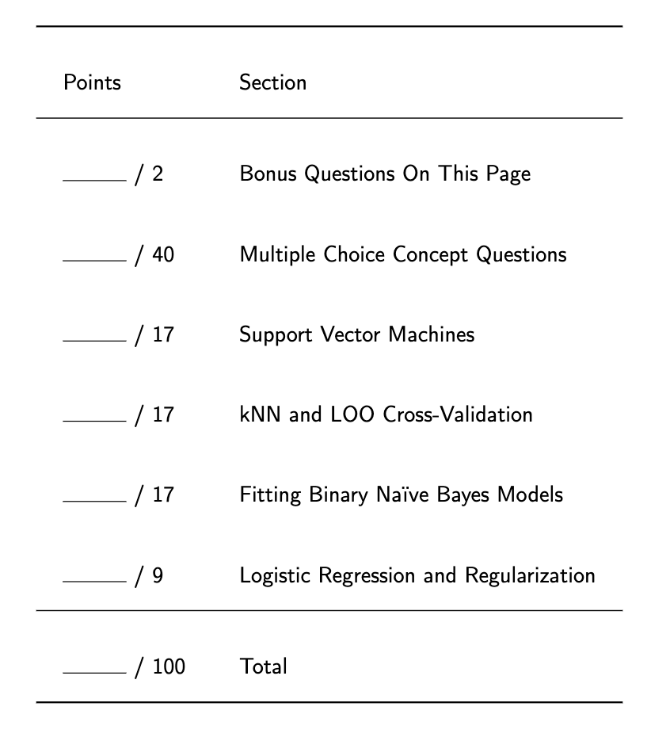
Midterm Structure

Slide 4
s
All (?)

Slide 5
General Concepts

Slide 6

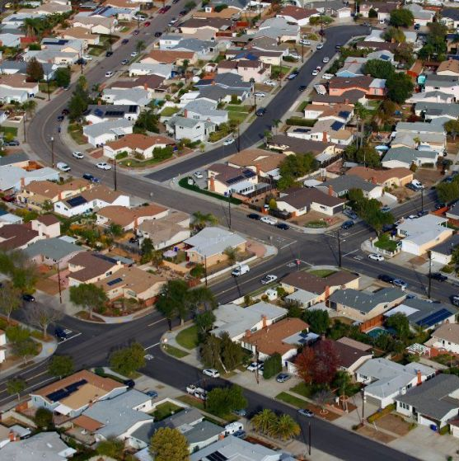
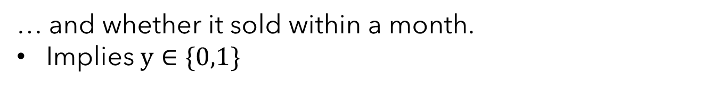
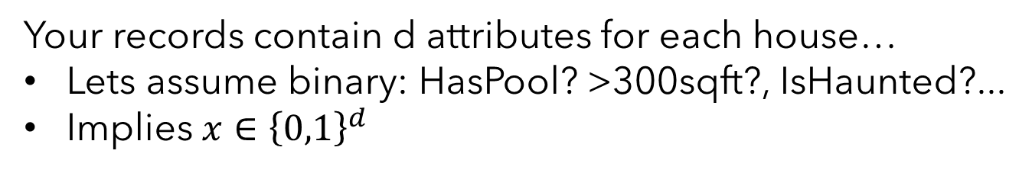
No Assumptions ➔ No Learning
It’s clear we are interested in mappings from input to output. Let’s get concrete.
Millow
(legally distinct
from Zillow)
Goal: Predict whether a house will sell within a month
Your records contain d attributes for each house…
Lets assume binary: HasPool? >300sqft?, IsHaunted?...
Implies $x∈{\left\{0,1\right\}}^{d}$
… and whether it sold within a month.
Implies $y∈\{0,1\}$
How many possible mappings from x to y are there?

Slide 7
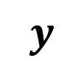


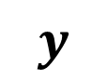

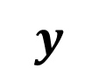
No Assumptions ➔ No Learning
How many possible mappings $g:{\left\{0,1\right\}}^{d}→\left\{0,1\right\}$from x to y are there?
What is a mapping? For each unique x, provide an output y.
$$x$$
$$y$$
$$x$$
$$y$$
$$x$$
$$y$$
0 0 … 0
0 0 … 1
.
.
.
1 1 … 1
0
1
.
.
.
0
0 0 … 0
0 0 … 1
.
.
.
1 1 … 1
1
1
.
.
.
0
0 0 … 0
0 0 … 1
.
.
.
1 1 … 1
1
0
.
.
.
0
…
Making no assumptions about the function -- $2^{2^{d}}$ possible!

Slide 8
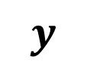


No Assumptions ➔ No Learning
Will data save us?
Each unique data point fills in one of these rows for us. Say we have $n$.
$$x$$
$$y$$
0 0 … 0
0 0 … 1
.
.
.
1 1 … 1
1
0
Still $2^{2^{d}−n}$ possible mappings.
Far, far too many.
We need to make some sort of assumption about the relationship between input and output.

Slide 9
What assumption is made for k-nearest neighbors?
That the relationship between input and output can be derived from a linear function.
The label changes smoothly as the features change in local regions.
That each feature affects the output independently.
kNN makes no assumptions.

Slide 10
What assumption is made for logistic regression?
That the relationship between input and output can be derived from a linear function.
The label changes smoothly as the features change in local regions.
That each feature affects the output independently.

Slide 11
What other algorithms share a similar assumption to logistic regression?
Naïve Bayes
Support Vector Machines
Perceptron
Linear Regression

Slide 12


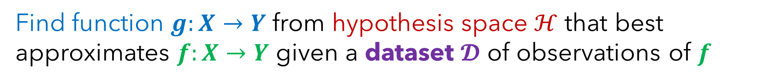
Error Decomposition for Function Approximation
Find function $g:X→Y$ from hypothesis space $ℋ$ that best approximates $f:X→Y$ given a dataset $𝓓$ of observations of $f$

Slide 13



Error Decomposition for Function Approximation
Find function $g:X→Y$ from hypothesis space $ℋ$ that best approximates $f:X→Y$ given a dataset $𝓓$ of observations of $f$
$$f$$
Actual function
$$ℋ$$
Adapted from Dhruv Batra

Slide 14
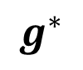
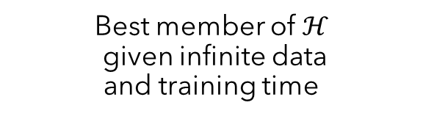
Error Decomposition for Function Approximation
Find function $g:X→Y$ from hypothesis space $ℋ$ that best approximates $f:X→Y$ given a dataset $𝓓$ of observations of $f$
Best member of $ℋ$ given infinite data and training time
$$g^{∗}$$
$$f$$
Modelling Error
Actual function
$$ℋ$$
Adapted from Dhruv Batra

Slide 15

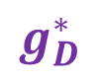
Error Decomposition for Function Approximation
Find function $g:X→Y$ from hypothesis space $ℋ$ that best approximates $f:X→Y$ given a dataset $𝓓$ of observations of $f$
Best member of $ℋ$ given infinite data and training time
$$g^{∗}$$
Best member of $ℋ$ given dataset D
$$f$$
Modelling Error
Estimation
Error
$$g_{D}^{∗}$$
Actual function
$$ℋ$$
Adapted from Dhruv Batra

Slide 16

Error Decomposition for Function Approximation
Find function $g:X→Y$ from hypothesis space $ℋ$ that best approximates $f:X→Y$ given a dataset $𝓓$ of observations of $f$
Best member of $ℋ$ given infinite data and training time
$$g^{∗}$$
Best member of $ℋ$
given dataset D
$$f$$
Modelling Error
Estimation
Error
$$g_{D}^{∗}$$
Actual function
Optimization Error
$$g$$
Actual model your learning algorithm found
$$ℋ$$
Adapted from Dhruv Batra

Slide 17
Which source(s) of error tend(s) towards zero with infinite data?
Optimization Error
Estimation Error
Modelling Error
Bayes Error

Slide 18
Which source(s) of error tend(s) towards zero as computation goes to infinity?
Optimization Error
Estimation Error
Modelling Error
Bayes Error

Slide 19
Consider a polynomial regression model of order m.
Suppose I train this model with m=2 and it performs poorly on both training and test data, but it performs well with m=5 . The initial model's poor performance is an example of ______________.
Optimization Error
Estimation Error
Modelling Error
Bayes Error

Slide 20




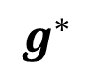
Reducing Sources of Error
Bigger, more flexible function class
$$g^{∗}$$
More data or more data efficient algorithms
$$f$$
Modelling Error
Estimation
Error
$$g_{D}^{∗}$$
More expensive optimization algorithms or models with easier optimization
Optimization Error
$$g$$
$$ℋ$$

Slide 21
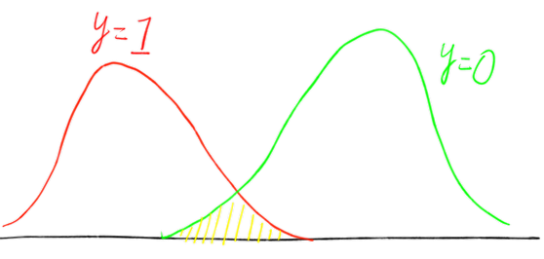



What is Bayes Error?
Bayes Error Irreducible error inherit in the function being approximated – nothing we can fix.
$$g\left(x\right)=1$$
$$g\left(x\right)=0$$

Slide 22
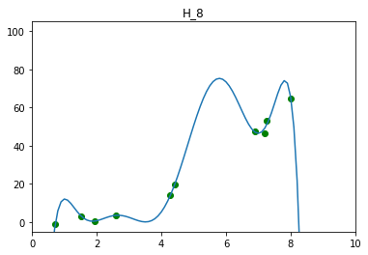
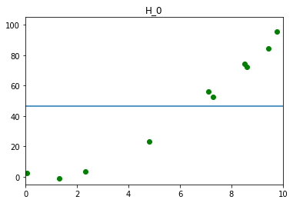
Overfitting, Underfitting, and Model Selection
Overfitting: Model performs well on training data, but poorly on held-out testing data.
Train
Test
Underfitting: Model performs poorly on training data. Likely also performs poorly on test data.
Train
Test
Model Selection: The exercise of finding a hypothesis space / model class that neither underfits or overfits. ← One of the reasons doing ML well is hard.

Slide 23
kNN

Slide 24




Intuition for your First Machine Learning Algorithm
$$x_{1}$$
$$x_{2}$$

Slide 25


Formalizing k-Nearest Neighbors
Classification Rule: Given a dataset of $𝒟={\left\{\left(x_{i}, y_{i}\right)\right\}}_{i=1}^{n}$, let $f_{k}(x)$be the prediction of a k-nearest neighbor classifier on a point $x$ such that:
Predict whichever label most neighbors have
k-nearest neighbor: $f_{k}\left(x\right)=arg\max_{y∈Y}{v_{y}}$
$$v_{y}=\sum_{i∈N_{k}(x)}{𝕀[y_{i}=y]}$$
Tally votes for each label from each neighbor
Note: The indicator function $𝕀[condition]$ is 1 if condition is true, and 0 otherwise.

Slide 26
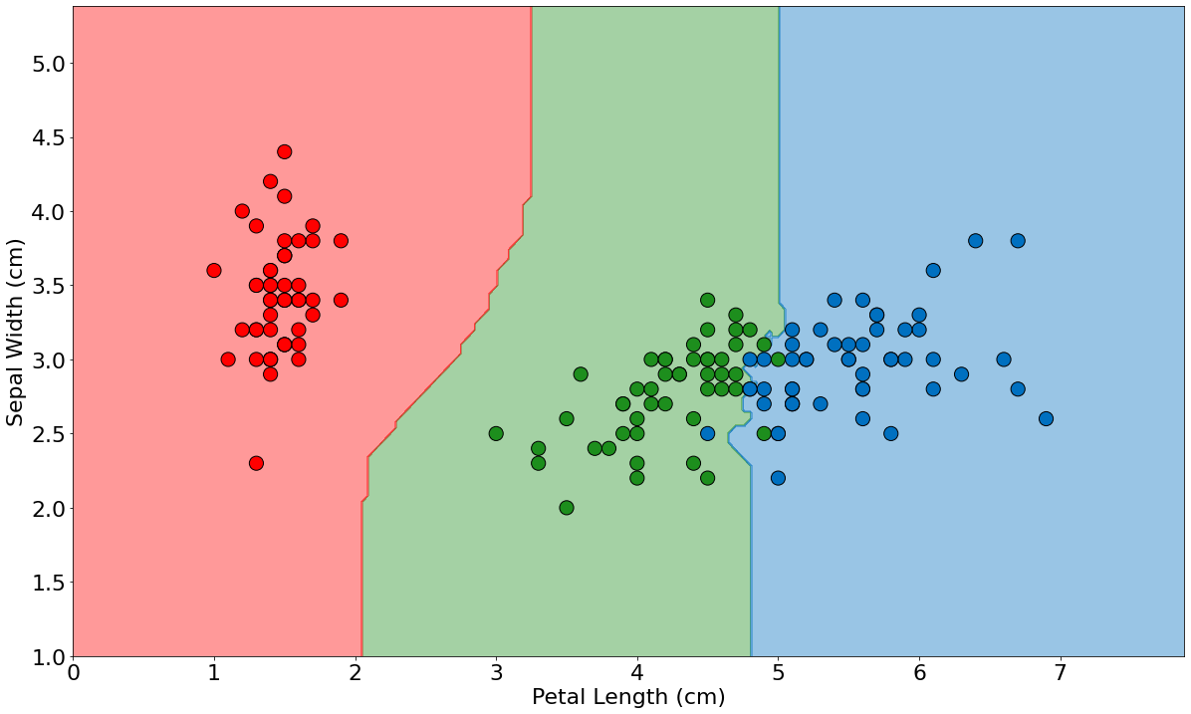
An Example: Iris Species Classification
Decisions made from a 5-nearest neighbor algorithm
setosa, versicolor, and virginica

Slide 27
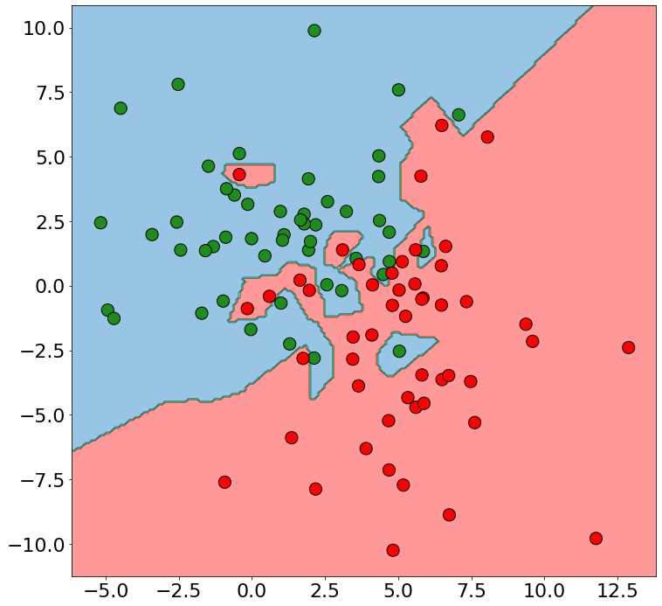
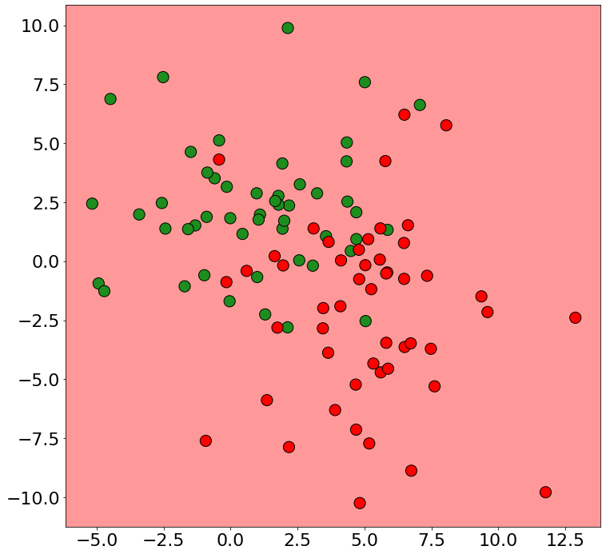
The Effect of Extreme k-values
k=1
k=n
At k=1, training error tends towards zero because each point is its own nearest neighbor!
At k=n, every point is a neighbor so the majority class in the dataset is predicted everywhere.

Slide 28
Formalizing k-Nearest Neighbors for Regression
Regression Rule: Given a dataset of $𝒟={\left\{\left(x_{i}, y_{i}\right)\right\}}_{i=1}^{n}$, let $f_{k}(x)$be the prediction of a k-nearest neighbor regressor on a point $x$ such that:
1-nearest neighbor: $f_{1}\left(x\right)=y_{N_{1}\left(x\right)}$
Predict average value of neighbors
k-nearest neighbor: $f_{k}\left(x\right)=\frac{1}{k}\sum_{i∈N_{k}(x)}{y_{i}}$

Slide 29
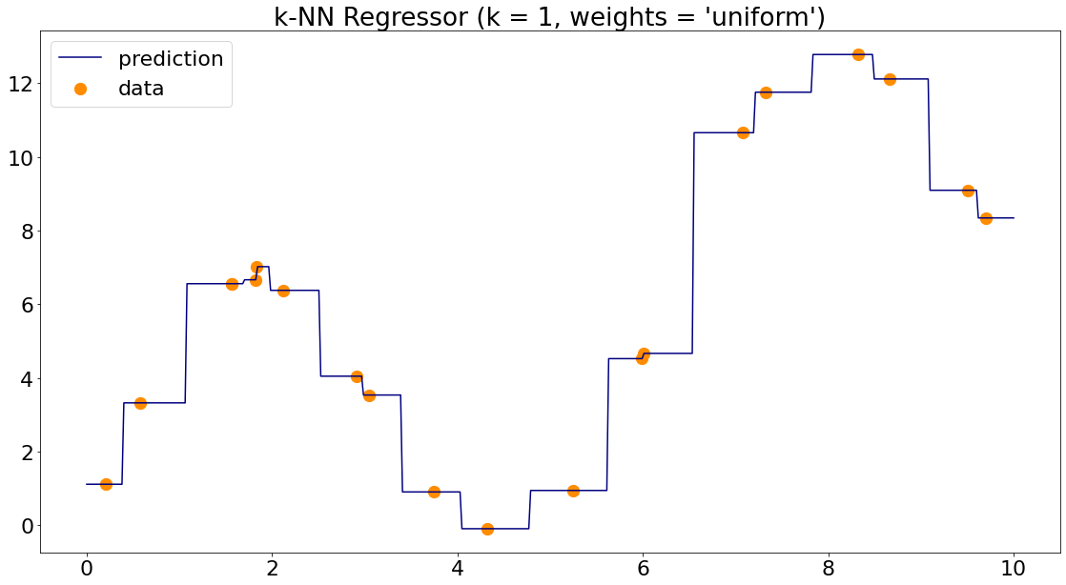
Formalizing k-Nearest Neighbors for Regression

Slide 30
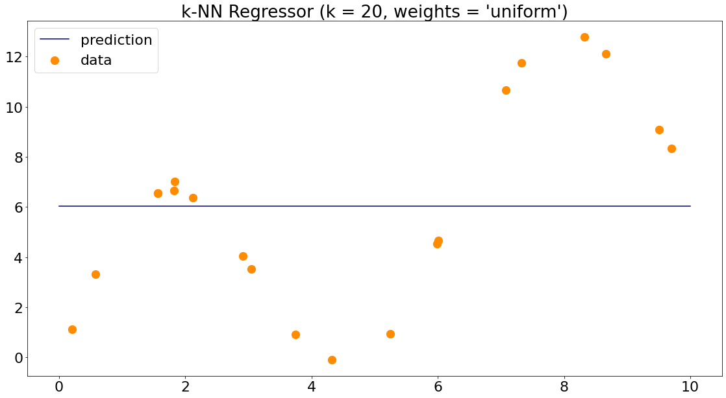
If k is set to n (the number of training examples), what will a k-NN regression model output for test points?
The average of the test set
An average of the nearest two points
The average of the training set
No idea.

Slide 31
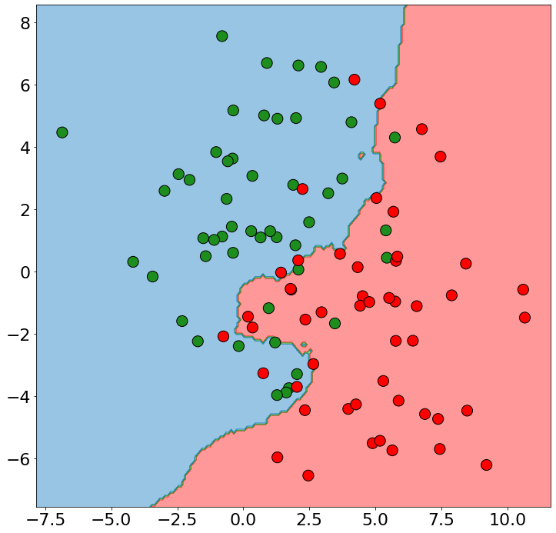
Practical Issues with k-NN
Finding Nearest Neighbors Can Be Expensive Computationally
Suppose our training set contains n, d-dimensional points. For a new point, finding the nearest neighbors requires computing distance to all n points.
O(nd) for every test point! (Most distances require O(d) operations)
Plenty of work to speed this up with smart data structures to quickly find approximate nearest neighbors – most focus on partitioning space
Kd-trees, Ball-trees, Locality Sensitive Hash, ….
Have to Store All the Datapoints
For massive datasets, requires lots of memory
Remove “unimportant examples”

Slide 32
Practical Issues with k-NN
Relative Scale of Features Matters for Most Distance Measures
Supposer we want to build a model to predict a person’s shoe size using the person’s height (feet) and weight (lbs) to make the prediction.
P1: (6.1, 175) P2: (5.7, 168) New Point: (6.1’, 170)
$$d\left(NP, P1\right)=\sqrt{{\left(6.1−6.1\right)}^{2}+{\left(175−170\right)}^{2}}=5$$
$$d\left(NP, P2\right)=\sqrt{{\left(6.1−5.7\right)}^{2}+{\left(170−168\right)}^{2}}≈2.04$$
Because weight has a larger range of values, its difference dominates the distance calculation.
Features should be normalized to have the same range of values (e.g. [0,1]), otherwise features with larger ranges will have bigger impact on the distance.

Slide 33
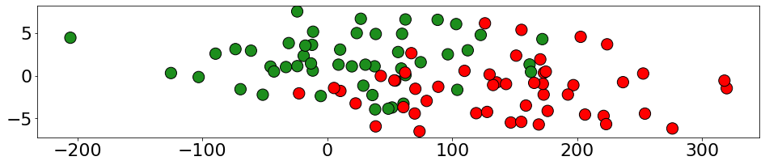
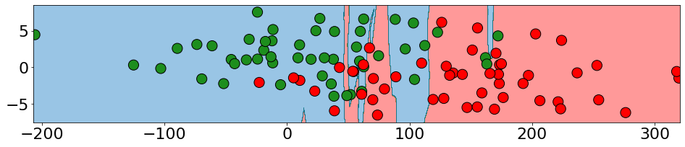
Practical Issues with k-NN
Relative Scale of Features Matters for Most Distance Measures
k=5, unwieghted

Slide 34
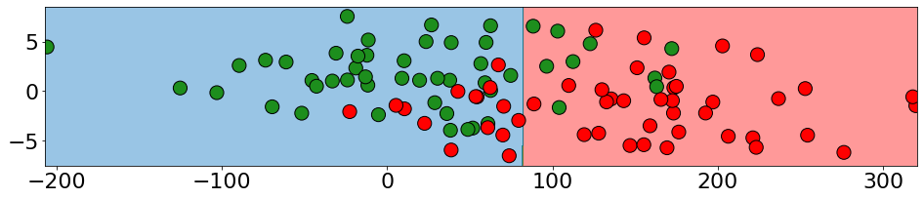
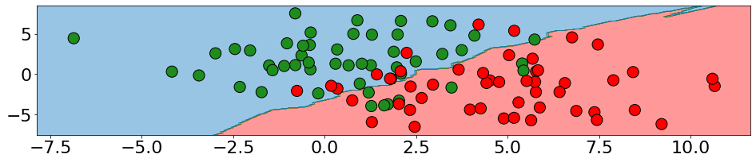
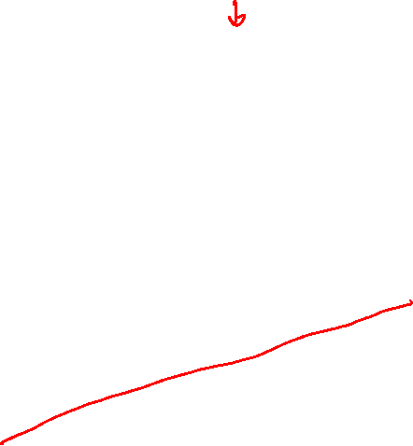
Practical Issues with k-NN
Relative Scale of Features Matters for Most Distance Measures
k=50, unwieghted
k=50, same feature scale

Slide 35
Hyperparameters of k-Nearest Neighbors
Seems like we’ve acquired a bunch of knobs we can turn and choices we can make when defining our “simple” model…. how do we choose them?
1) A distance metric (How do we tell which points are “close”?)
Euclidean / Manhattan / Some exotic Minkowski distance?
2) k (How many neighboring points do we look at?)
1? 5? 10? n/4?
3) Output Function (Given a set of neighbors, how do we compute the output?)
To weight or not to weight?
4) Weighting Function (Do all k neighbors contribute equally?)
If weighting, what function? $\frac{1}{d\left(x,x_{i}\right)}$? $e^{−\frac{d{\left(x,x_{i}\right)}^{2}}{σ}}$? If so, what bandwidth/variance?

Slide 36
Model Selection – The Validation Set
The training set won’t help us avoid overfitting and the test set is off-limits.
Get a third set of datapoints and call it the validation set. May “create” this set of datapoints by randomly splitting off some fraction of the training set.
Training Data
Test Data
(Do not touch!)
Training Data
Validation Data
Test Data
(Do not touch!)
Model Selection Procedure:
Pick a set of hyperparameters
Train your model on the training set
Evaluate on the validation set
If happy, stop. Otherwise loop back to 1.
At very end when you’ve picked the best hyperparameters you can, then you evaluate on test and report results. No more tuning at this point.

Slide 37
Model Selection – K-fold Cross Validation
Idea: Make many validation sets and evaluate model choices by average performance over them.
K-Fold Cross Validation Procedure
Randomly split the training set into K equally-sized subsets
Subsets should have similar distributions
For each subset i:
Combine all subsets except i and train the model on this.
Evaluate the model on subset i.
Compute average performance over these K train/evaluation runs.
Training Data
Subset 1
Subset 2
Subset 3
Subset 4
Subset 1
Subset 2
Subset 3
Subset 4
Subset 1
Subset 2
Subset 3
Subset 4
Subset 1
Subset 2
Subset 3
Subset 4
Example: 4-fold cross validation

Slide 38
Model Selection – K-fold Cross Validation
Idea: Make many validation sets and evaluate model choices by average performance over them.
Training Data
Subset 1
Subset 2
Subset 3
Subset 4
Train on subsets 2,3,4. Test on subset 1 → $perf_{1}$
Subset 1
Subset 2
Subset 3
Subset 4
Train on subsets 1,3,4. Test on subset 2 → $perf_{2}$
Subset 1
Subset 2
Subset 3
Subset 4
Train on subsets 1,2,4. Test on subset 3 → $perf_{3}$
Subset 1
Subset 2
Subset 3
Subset 4
Train on subsets 1,2,3. Test on subset 4 → $perf_{4}$
Example: 4-fold cross validation
Estimated validation performance is $\frac{1}{4}(\sum_{i}{perf_{i})}$

Slide 39
Model Selection – K-fold Cross Validation
Model Selection Procedure:
Pick a set of hyperparameters
Train your model on the training set
Evaluate on the validation set
If happy, stop. Otherwise loop back to 1.
At very end when you’ve picked the best hyperparameters you can, then you evaluate on test and report results. No more tuning at this point.
Model Selection Procedure with K-Fold Cross Validation:
Pick a set of hyperparameters
Perform K-Fold Cross Validation to estimate performance
If happy, stop. Otherwise loop back to 1.
At very end when you’ve picked the best hyperparameters you can, then you evaluate on test and report results. No more tuning at this point.

Slide 40
Model Selection – Leave-One-Out Cross Validation
What if K = n? Then we treat only one example as validation at a time. Call it Leave-One-Out.
Same approach as before, but we are going to have to train a LOT of models. May be prohibitively expensive for large, complicated, slow models.
k-NN: LOO cross validation is super easy in k-NN and other “lazy” learners
Simply classify each training point but don’t let it select itself as a nearest neighbor.
…
Example: Leave-One-Out Cross Validation with 1-nn

Slide 41
What is the leave-one-out cross validation accuracy for a 1-nearest neighbor model on this dataset:
5/6th
2/6th
3/6th
1/6th

Slide 42
Example Leave-One-Out Cross Validation
Accuracy: 0
Accuracy: 0
Accuracy: 1
3
Accuracy: 0
Accuracy: 0
Accuracy: 0
Leave-One-Out Cross Validation Accuracy Estimate: 1/6 or $≈$16.6%

Slide 43
Probability / MLE / MAP

Slide 44
Your First Probabilistic Learning Algorithm: MLE
The intuitive answer is that 3/5 “fits the data” the best. We’ll formalize that notion this lecture.
Maximum Likelihood Estimation – Find parameters that make the observed data most likely.
Assume a probabilistic model of how the data was generated $x∼P(x;θ)$ parameterized by some set of parameters $θ$
Find ${\hat{θ}}_{MLE}$ that maximizes the probability (or likelihood) of generating the training data under the probabilistic model.
Why MLE?
Often leads to “natural” or intuitive parameter estimates
MLE is optimal if model class is correct (e.g. Normal model for normally distributed data)

Slide 45
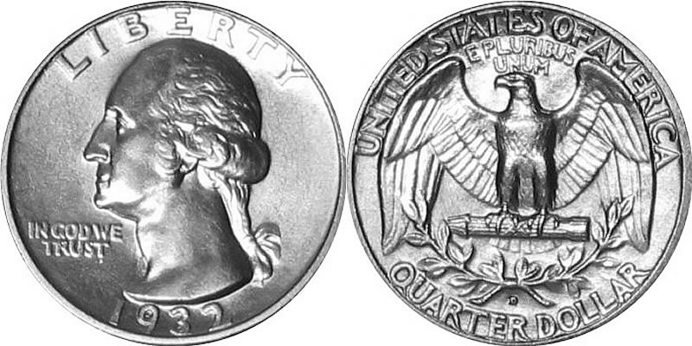
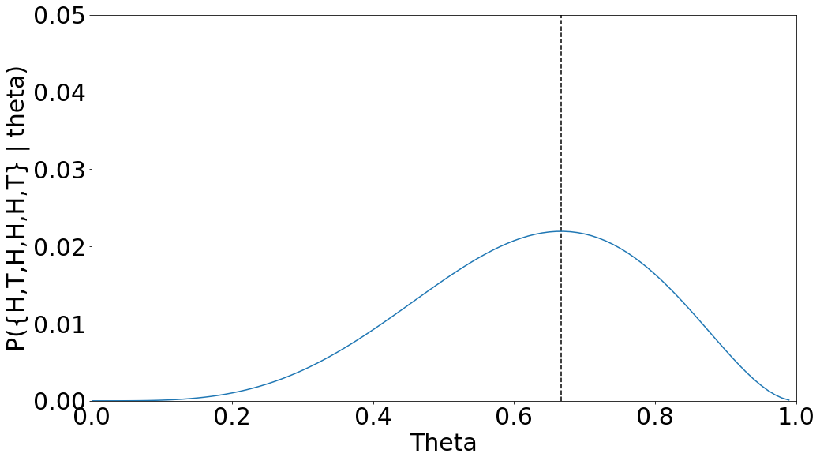
Baby Steps: Estimating the Bias of a Coin
Dataset: Suppose you observe a coin flipped 6 times such that $D=\{H, T, H, H, H,T\}$
Model Assumption: Assume the probability of getting heads on the coin is some unknown $θ$.
Write out likelihood of the training data as a function of parameters $θ$:
$$𝓛\left(θ\right)=P\left(D∣θ\right)=P\left(\left\{H,T,H,H,H,T\right\}|θ\right)$$
$$=P\left(H|θ\right)P\left(T|θ\right)P\left(H|θ\right)P\left(H|θ\right)P\left(H|θ\right)P(T|θ)$$
$$=θ(1−θ)θθθ(1−θ)$$
$$=θ^{4}{\left(1−θ\right)}^{2}$$
Find ${\hat{θ}}_{MLE}=\underset{θ}{argmax} 𝓛\left(θ\right)$:
Any guesses what the peak of the graph is?
$$θ^{4}{\left(1−θ\right)}^{2}$$
$$\frac{4}{6}=\frac{\#Heads}{\#Heads+\#Tails}$$
Is this generally true?

Slide 46
What assumption did we make when we set $P\left(\left\{H,T,H,H,H,T\right\}|θ\right)=P\left(H|θ\right)P\left(T|θ\right)P\left(H|θ\right)P\left(H|θ\right)P\left(H|θ\right)P(T|θ)$?
$θ$ was greater than 0.
$θ$ was greater than 0.5
Each coin flip was independent
Each coin flip was dependent

Slide 47
General Case: Estimating the Bias of a Coin with MLE
Dataset: Let $X_{i}$ be a binary random variable (H→1, T→0). Given a dataset $D={\left\{x_{i}\right\}}_{i=1}^{N}$ representing a coin being flipped N times. (e.g. {H,T,H,H,H,T} → {1,0,1,1,1,0})
Model Assumption: Assume that X is distributed according to a Bernoulli distribution with parameter $θ$ such that: $P\left(x\right)=θ^{x}{\left(1−θ\right)}^{1−x}$

Slide 48
General Case: Estimating the Bias of a Coin with MLE
Dataset: Let $X_{i}$ be a binary random variable (H→1, T→0). Given a dataset $D={\left\{x_{i}\right\}}_{i=1}^{N}$ representing a coin being flipped N times. (e.g. {H,T,H,H,H,T} → {1,0,1,1,1,0})
Model Assumption: Assume that X is distributed according to a Bernoulli distribution with parameter $θ$ such that: $P\left(x\right)=θ^{x}{\left(1−θ\right)}^{1−x}$
Write out likelihood of the training data as a function of parameters $θ$:
Collect all the like terms and sum their exponents
$$𝓛\left(θ\right)=P\left(D∣θ\right)=\prod_{i=1}^{N}{P\left(x_{i} ∣ θ\right)=\prod_{i=1}^{N}{θ^{x_{i}}{\left(1−θ\right)}^{1−x_{i}}}}$$
$$=θ^{{∑x}_{i}}{\left(1−θ\right)}^{∑(1−x_{i})}$$
Now our goal is to find $θ$ that maximizes this
$$=θ^{\#Heads}{\left(1−θ\right)}^{\#Tails}$$
Find ${\hat{θ}}_{MLE}=\underset{θ}{argmax} 𝓛\left(θ\right)$: How can we do this analytically?

Slide 49

Concepts in Bayesian Statistics
We will very often be most interested in the posterior.
Likelihood
How likely theta makes the dataset
Posterior
Belief about theta after evidence and prior belief combined
$$P\left(θ | D\right)=\frac{P\left(D | θ\right)P(θ)}{P(D)}$$
Prior
Belief about theta provided by human
Constant with respect to theta so typically will not address
Important to note – the posterior is a distribution over theta!

Slide 50
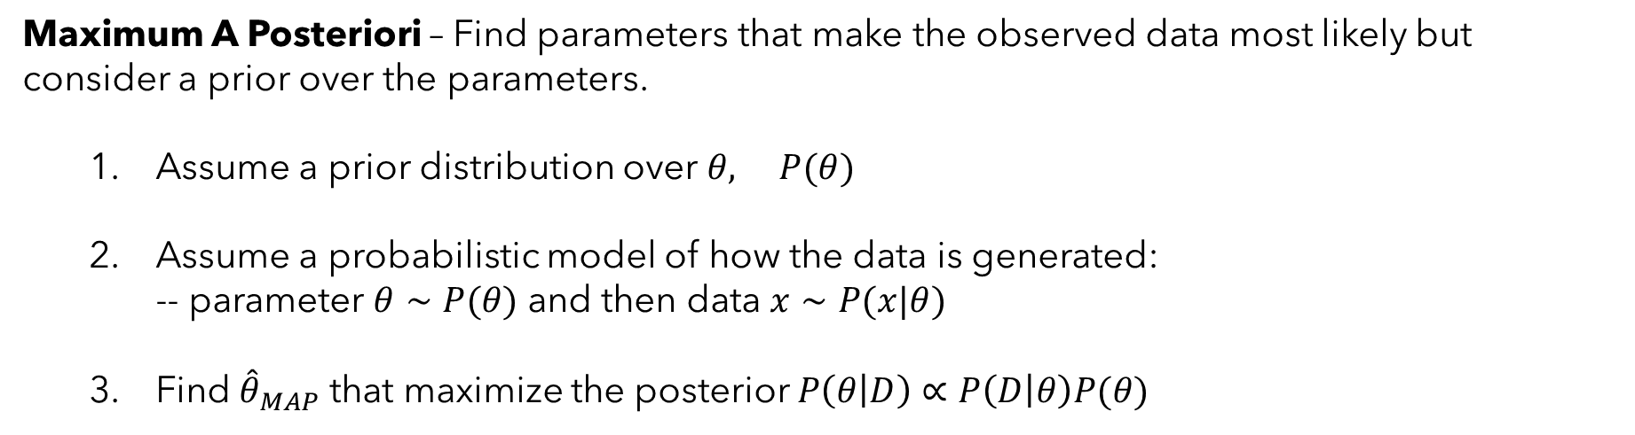
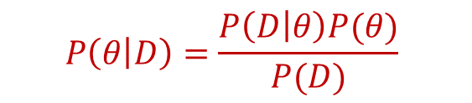
Your Second Statistical Learning Algorithm: MAP
Maximum A Posteriori – Find parameters that make the observed data most likely but consider a prior over the parameters.
Assume a prior distribution over $θ, P(θ)$
Assume a probabilistic model of how the data is generated: -- parameter $θ∼P(θ)$ and then data $x∼P(x|θ)$
Find ${\hat{θ}}_{MAP}$ that maximize the posterior $P\left(θ | D\right)∝P\left(D | θ\right)P(θ)$
$$P\left(θ | D\right)=\frac{P\left(D | θ\right)P(θ)}{P(D)}$$
Why MAP?
Rigorous framework to combine observations (likelihood) with beliefs (prior)

Slide 51
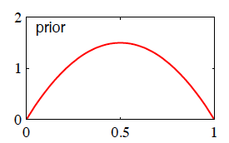
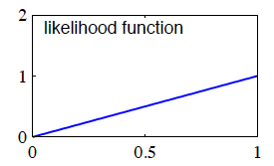
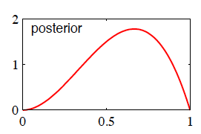
Effect of Prior on Coin Flip
Prior = Beta(2,2)
θ_{prior} = 0.5
Dataset = {H}
L(θ) = θ
θ_{MLE} = 1
Posterior = Beta(3,2)
θ_{MAP} = (3-1)/(3+2-2) = 2/3

Slide 52
What happens as the number of observed data points gets larger?
$${\hat{θ}}_{MAP}=\frac{\#H+β_{H}−1}{\#H+β_{H}+\#T+β_{T}−2}$$
The fake heads/tails from the prior matter more
The fake heads/tails from the prior matter less
You lost me with this Bayesian stuff

Slide 53

What is the difference between a MLE and MAP estimate?
MLE makes assumptions about the parameters before observing data
One has more vowels
There are no differences
MAP maximizes the posterior (likelihood * prior) whereas MLE maximizes the likelihood

Slide 54
Linear Regression

Slide 55

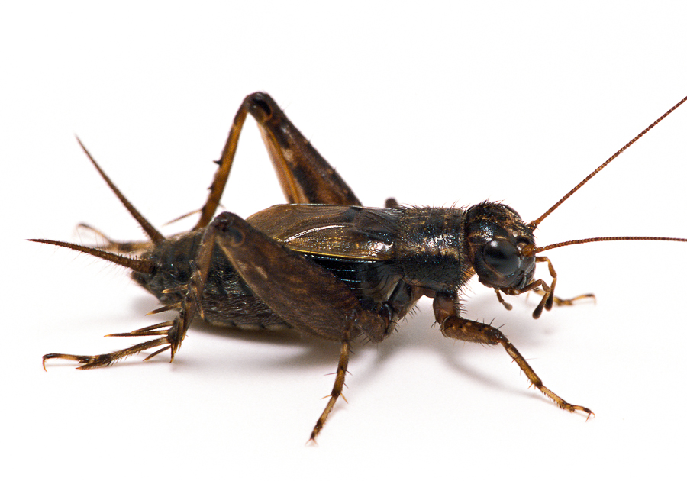
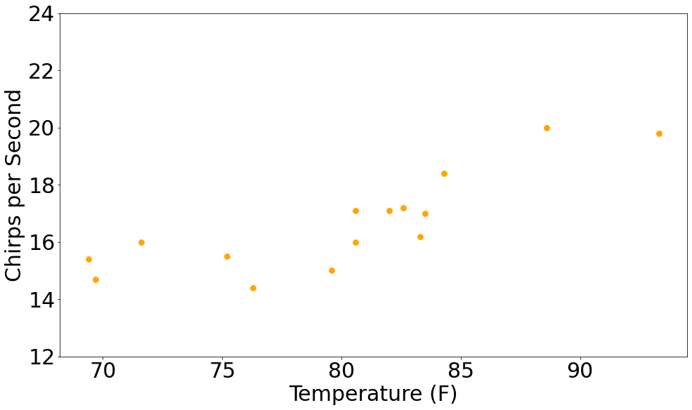

An Example Linear Regression Problem
Can we predict how annoying crickets will be based on the temperature?
X | Y
F | CPS
88.6 | 20
71.6 | 16
93.3 | 19.8
84.3 | 18.4
80.6 | 17.1
75.2 | 15.5
69.7 | 14.7
82 | 17.1
69.4 | 15.4
83.3 | 16.2
79.6 | 15
82.6 | 17.2
80.6 | 16.
83.5 | 17
76.3 | 14.4
Data from: The Song of Insects by Dr.G.W. Pierce, Harvard College Press

Slide 56
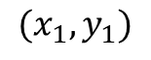
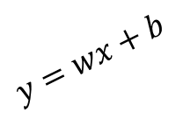
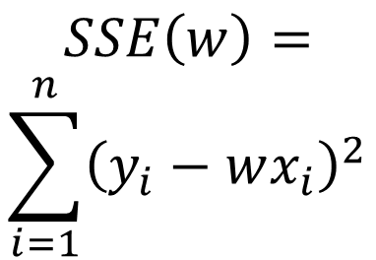
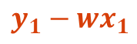
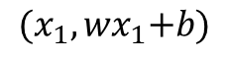
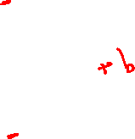
Visualizing Sum of Squared Error
$${(x_{1}, wx}_{1}+b)$$
$$SSE\left(w\right)= \\ \sum_{i=1}^{n}{{\left(y_{i}−wx_{i}\right)}^{2}}$$
$$y=wx+b$$
$$y_{1}−{wx}_{1}$$
$$(x_{1},y_{1})$$
Data from: The Song of Insects by Dr.G.W. Pierce, Harvard College Press

Slide 57
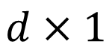
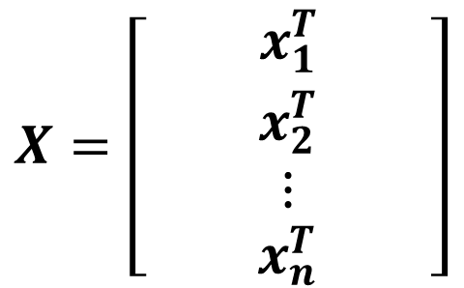
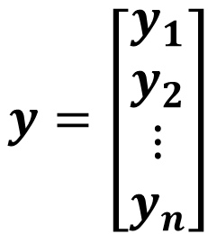
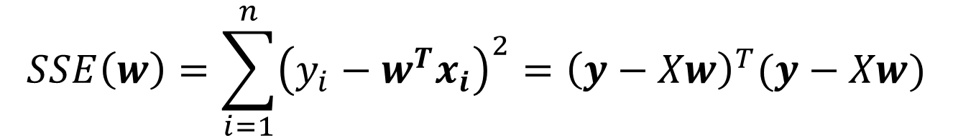
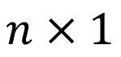
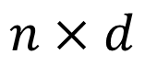
Multidimensional Linear Regression
Can we express it entirely as matrix operations?!
X |  | Y
F | H | CPS
88.6 | 30 | 20
71.6 | 28 | 16
93.3 | 32 | 19.8
84.3 | 30 | 18.4
80.6 | 29 | 17.1
75.2 | 24 | 15.5
69.7 | 20 | 14.7
82 | 30 | 17.1
69.4 | 19 | 15.4
83.3 | 30 | 16.2
79.6 | 28 | 15
82.6 | 32 | 17.2
80.6 | 30 | 16.
83.5 | 30 | 17
76.3 | 24 | 14.4
$$X=\left[\begin{matrix}{ x}_{1}^{T} \\ x_{2}^{T} \\ ⋮ \\ x_{n}^{T}\end{matrix}\right]$$
$$y=\left[\begin{matrix}y_{1} \\ y_{2} \\ ⋮ \\ y_{n}\end{matrix}\right]$$
$$n×d$$
$$n×1$$
$$w={\left[w_{1}, w_{2}, …, w_{d}\right]}^{T}$$
$$d×1$$
$$SSE\left(w\right)=\sum_{i=1}^{n}{{\left(y_{i}−w^{T}x_{i}\right)}^{2}}={\left(y−Xw\right)}^{T}(y−Xw)$$

Slide 58
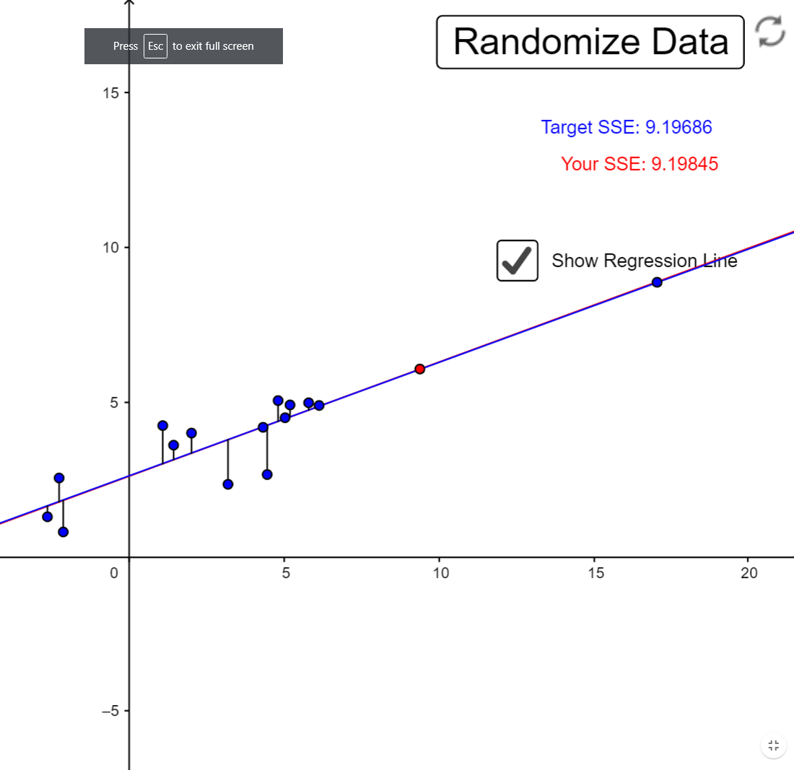
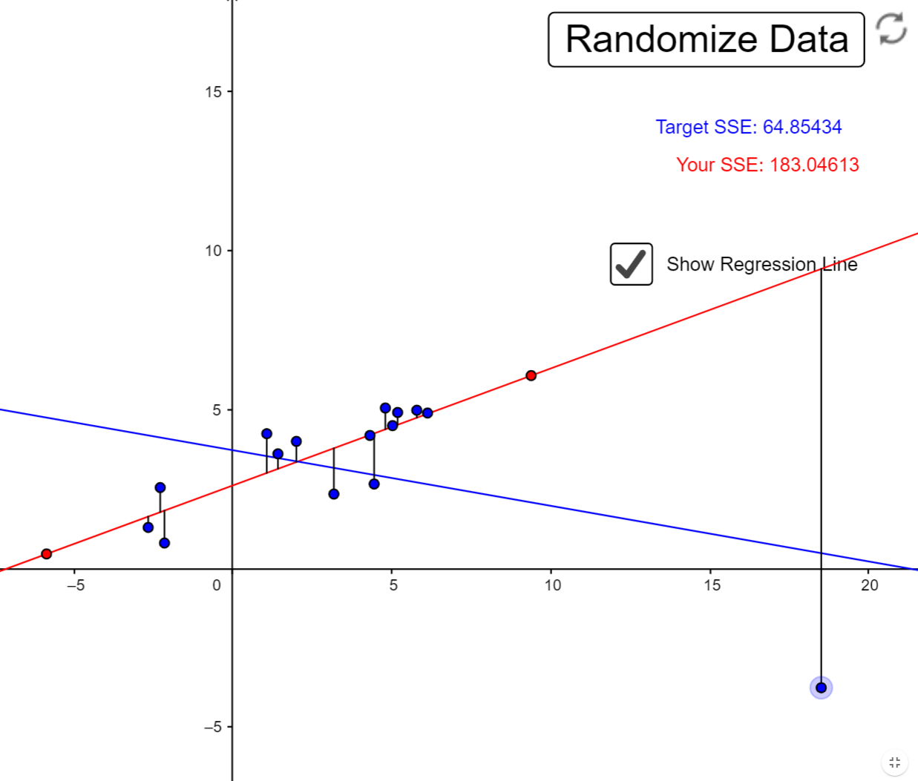
Robustness of Ordinary Least Squares (OLS)
Minimizing sum of squared error is very sensitive to outliers.
Probabilistic view: very little density in the tails of Gaussians.
https://www.geogebra.org/m/xC6zq7Zv

Slide 59
Multidimensional Linear Regression
$$SSE\left(w\right)={\left(y−Xw\right)}^{T}(y−Xw)$$
Take derivative and set equal to zero. Get closed-form solution:
$$2X^{T}\left(y−Xw\right)=\vec{0}$$
$$⟹X^{T}Xw=X^{T}y$$
$$⟹w^{∗}={\left(X^{T}X\right)}^{−1}X^{T}y$$

Slide 60






Let’s view this from a different angle
Our “generative story” for this data:
$$y_{i}=w^{T}x_{i}+𝒩\left(0,σ\right)$$
$$y$$
$$True line: y=w^{T}x$$
$$x$$
$$x_{i}$$

Slide 61

Let’s view this from a different angle
Okay. Still not seeing why we care? Let’s start doing MLE.
Dataset: Given a dataset $D={\left\{(x_{i},y_{i})\right\}}_{i=1}^{N}$ assume the above conditional probability.
Model assumption:
$$y_{i}=w^{T}x_{i}+𝒩\left(0,σ\right) ⟹P\left(y_{i} | x_{i}, w\right)=𝒩\left(w^{T}x_{i},σ\right)$$
Write out likelihood of the training data as a function of parameters $θ$:
$$𝓛\left(θ\right)=P\left(D∣θ\right)=\prod_{i=1}^{N}{P\left(y_{i} ∣ w\right)=\prod_{i=1}^{N}{\frac{1}{σ\sqrt{2π}}e^{−\frac{{\left(y_{i}−w^{T}x_{i}\right)}^{2}}{2σ^{2}}}}}$$
Yikes. Let’s apply a log and write the log-likelihood to clean this up:
$$𝓛𝓛\left(θ\right)=P\left(D∣θ\right)=N\log\left(\frac{1}{σ\sqrt{2π}}\right)−\frac{1}{2σ^{2}}\sum_{i=1}^{N}{{\left(y_{i}−w^{T}x_{i}\right)}^{2}}$$

Slide 62

Let’s view this from a different angle
Wait… this part is looking familiar...
$$𝓛𝓛\left(θ\right)=N\log\left(\frac{1}{σ\sqrt{2π}}\right)−\frac{1}{2σ^{2}}\sum_{i=1}^{N}{{\left(y_{i}−w^{T}x_{i}\right)}^{2}}$$
How do we maximize this log-likelihood with respect to w?
Find $w^{∗}$ such that $\sum_{i=1}^{N}{{\left(y_{i}−w^{T}x_{i}\right)}^{2}}$ is as small as possible
AKA find weights that minimize the sum of squared error!
Linear regression is just MLE of a linear model with Gaussian noise!

Slide 63

Beyond Lines but Still Linear?
Fitting lines seems cool but many, many functions of interest aren’t lines.

Slide 64




Beyond Lines but Still Linear?
Idea: Solve a linear regression problem in a feature space that is non-linear in the original input! For example, could add a $x^{2}$ term.
$$X$$ | X | Y
 | $$x$$ | Y
1 | -0.25 | -4.47
1 | 0.9 | 11.08
1 | 0.46 | -10.44
1 | 0.2 | 7.19
1 | -0.69 | 7.08
1 | -0.69 | 5.38
1 | -0.88 | 11.55
1 | 0.73 | 10.85
1 | 0.2 | 7.85
1 | 0.42 | -8.31
$$X′$$ | X |  | Y
 | $$x$$ | $$x^{2}$$ | Y
1 | -0.25 | 0.06 | -4.47
1 | 0.9 | 0.81 | 11.08
1 | 0.46 | 0.21 | -10.44
1 | 0.2 | 0.04 | 7.19
1 | -0.69 | 0.48 | 7.08
1 | -0.69 | 0.48 | 5.38
1 | -0.88 | 0.77 | 11.55
1 | 0.73 | 0.53 | 10.85
1 | 0.2 | 0.04 | 7.85
1 | 0.42 | 0.18 | -8.31
Solve for w such that:
$$y_{i}=w_{0}1+w_{1}x_{i}+w_{2}x_{i}^{2}$$
Linear function of non-linear transformations of x
$$y_{i}= \left[1, x_{i},x_{i}^{2}\right]\left[\begin{matrix}w_{0} \\ w_{1} \\ w_{2}\end{matrix}\right]$$

Slide 65





Linear Regression over Basis Functions
Let’s generalize this further.
Each data point has $d$ features. Let $Φ: ℝ^{d}→ℝ^{d^{′}}$ be our basis function. Can make any arbitrary choice we want here based on how the data looks.
$$Φ_{A}\left(x\right)={\left[\begin{aligned}1 \\ x_{1} \\ x_{2} \\ x_{1}x_{2} \\ sin⁡(x_{1}) \\ cos⁡(x_{2})\end{aligned}\right]}^{T}$$
$$Φ_{B}\left(x\right)={\left[\begin{aligned}1 \\ x_{1}x_{2} \\ x_{1}x_{3} \\ x_{1}x_{4} \\ ⋮ \\ x_{n}x_{n}\end{aligned}\right]}^{T}$$
$$x={\left[\begin{aligned}x_{1} \\ x_{2} \\ ⋮ \\ x_{n}\end{aligned}\right]}^{T}$$
$$Φ_{C}\left(x\right)={\left[\begin{aligned}\begin{aligned}1 \\ ∏x_{i}\end{aligned} \\ \sqrt{x_{1}}\end{aligned}\right]}^{T}$$
$$1×d$$
No matter what we choose, the procedure is the same. Replace each $x$ (row) in our data matrix with $Φ\left(x\right)$, then solve the linear regression problem.

Slide 66

Linear Regression over Basis Functions
$Φ\left(x\right)=$ $\left[\begin{matrix}\begin{matrix}1 & x\end{matrix} & \begin{matrix}x^{2} & sin(10x)\end{matrix}\end{matrix}\right]$

Slide 67

Can I use linear regression over basis functions to find the weights w for the following function?
$$w_{1}x_{1}x_{2}+w_{2}x_{2}log⁡x_{2}$$
Yes
No
Maybe if you are tricky.

Slide 68

Can I use linear regression over basis functions to find the weights w for the following function?
$$x_{1}^{w_{1}}x_{2}^{w_{2}}$$
Yes
No
Maybe if you are tricky.

Slide 69



Effect of Regularization
$$w^{∗}=\underset{w}{argmin}{ {\left(y−Xw\right)}^{T}\left(y−Xw\right)+λw^{T}w}$$
$$w^{∗}={\left(X^{T}X+λI\right)}^{−1}X^{T}y$$

Slide 70
Summary of Regularization
Regularization is a much more general concept in machine learning. Consider any learning task to minimize a loss $ℒ(w)$ on the training data – could add a regularizer term.
$$w^{∗}=\underset{w}{argmin}{ℒ\left(w\right)+λ∗regularizer(w)}$$
Generally speaking, larger $λ′s$ lead to simpler models and reduce overfitting, smaller $λ^{′}s$ lead to more complex models but improve fit on training data.
Most commonly used regularizers are based on the norm of the weight vector.

Slide 71
Logistic Regression

Slide 72



Why not regress probabilities directly?
Introducing the logistic function:
May also see it referred to as a sigmoid function or “logit” function
Logistic Function $σ\left(z\right)=\frac{1}{1+e^{−z}}$
Maps $(−∞, ∞)$ to $(0,1)$

Slide 73

Logistic Regression
Logistic Regression Model Assumption:
$$P\left(y_{i}=1 | x_{i};w\right)=σ\left(w^{T}x_{i}\right)=\frac{1}{1+e^{−w^{T}x_{i}}}$$
$$P\left(y_{i}=0 | x_{i};w\right)=1−σ\left(w^{T}x_{i}\right)=\frac{e^{−w^{T}x_{i}}}{1+e^{−w^{T}x_{i}}}$$

Slide 74





Logistic Regression
Logistic Regression Model’s Decision Boundary:
Predict $1$ if
$$P\left(y_{i}=1 | x_{i};w\right)>P(y_{i}=0|x_{i};w)$$
$$⇒ \frac{P\left(y_{i}=1 | x_{i};w\right)}{P(y_{i}=0|x_{i};w)} > 1$$
Divide both sides by $P(y_{i}=0|x_{i};w)$
$$⇒ e^{w^{T}x} > 1$$
Just some algebra
This tells us the decision boundary is the line $w^{T}x=0$
Log of both sides
$$⇒ w^{T}x >0$$

Slide 75

Logistic Regression
Example logistic regression decision boundary – linear in the features.

Slide 76
Let’s Be Sure We Understand Lines

Slide 77





Let’s Be Sure We Understand Lines
$$y=−2x+3$$
$$−3+y+2x=0$$
$$−3+\left[1 2 \right]\left[\begin{aligned}y \\ x\end{aligned}\right]=0$$
$$w=\left[1 2\right]$$
$$b=−3$$

Slide 78




Let’s Be Sure We Understand Lines
$$−3+\left[1 2 \right]\left[\begin{aligned}y \\ x\end{aligned}\right]=0$$
$$w=\left[1 2\right]$$
$$b=−3$$
$$−3+\left[1 2\right]\left[\begin{aligned}y=0 \\ x=0\end{aligned}\right]=−3$$

Slide 79



Let’s Be Sure We Understand Lines
$$−3+\left[1 2 \right]\left[\begin{aligned}y \\ x\end{aligned}\right]=0$$
$$3+\left[−1, −2 \right]\left[\begin{aligned}y \\ x\end{aligned}\right]=0$$
$$w=\left[−1, −2\right]$$
$$b=3$$

Slide 80



Let’s Be Sure We Understand Lines
$$−3+\left[1 2 \right]\left[\begin{aligned}y \\ x\end{aligned}\right]=0$$
$$3+\left[−1, −2 \right]\left[\begin{aligned}y \\ x\end{aligned}\right]=0$$
$$w=\left[−1, −2\right]$$
$$b=3$$
$$3+\left[−1,−2 \right]\left[\begin{aligned}y=0 \\ x=0\end{aligned}\right]=3$$

Slide 81

MLE for Logistic Regression
So we have an expression for the gradient but can’t find the optimal analytically…
$$∇−logP\left(D∣w\right)=\sum_{i=1}^{N}{∇l_{i}}=\sum_{i=1}^{N}{\left(σ\left(w^{T}x_{i}\right)−y_{i}\right)x_{i}}$$
Gradient Descent Algorithm for Logistic Regression
w = random(d) // randomly initialize weight vector
Repeat:
$∇=\vec{0}$
for each example $x_{i}, y_{i}∈D$: // compute gradient
${\hat{y}}_{i}=\frac{1}{1+e^{−w^{T}x_{i}}}$ // compute the prediction for this point
$∇+=\left({\hat{y}}_{i}−y_{i}\right)x_{i}$ // compute gradient of loss of point and sum
$w=w−α∇$ // take a step in the opposite direction of gradient
Until $\left|∇\right|≤ε$ // keep taking steps until convergence

Slide 82

An example of Logistic Regression with Gradient Descent

Slide 83
Perceptron

Slide 84



Perceptron vs Logistic Regression
Logistic Function
$$σ\left(z\right)=\frac{1}{1+e^{−z}}$$
Sign Function
$$sign\left(z\right)=\left\{\begin{aligned}1 z≥0 \\ −1 else \end{aligned}\right.$$

Slide 85


Perceptron vs Logistic Regression
Logistic Regression
Perceptron
$$P\left(y_{i}=1 | x_{i};w\right)=σ\left(w^{T}x_{i}\right)=\frac{1}{1+e^{−w^{T}x_{i}}}$$
$$y_{i}=sign(w^{T}x_{i})$$
$$y_{i}=argmax_{y} P(y|x_{i};w)$$
Linear Classifier
Linear Classifier
Probabilistic Interpretation
No useful probabilistic interpretation (mostly just geometry)
Trained with gradient descent or other optimization methods
Trained with the “perceptron” algorithm

Slide 86


The Perceptron: Learning Algorithm
Trained with a simple iterative algorithm
Perceptron Learning Algorithm
w = random(d)
Repeat:
for each example $x_{i}, y_{i}∈D$:
if $y_{i}w^{T}x_{i}<0:$ // if misclassification
$w=w+αy_{i}x_{i}$
Until no errors or max iterations

Slide 87


The Perceptron: Limitations
Perceptron Learning Algorithm
w = random(d)
While still errors or max iterations:
for each example $x_{i}, y_{i}∈D$:
if $yw^{T}x_{i}<0:$ $w=w+αy_{i}x_{i}$
Different solutions depending on initialization and order of visiting examples.
Correcting for a misclassification could move the decision boundary so much that previously correct examples are now misclassified.
As such it must go over the training examples multiple times. Each time it goes through the whole training set, it is called an epoch.
It will terminate if no update is made to w during one epoch

Slide 88



The Perceptron: Limitations
$$x_{2}$$
This algorithm is guaranteed to converge if data is linearly separable – i.e., it reaches a solution in finitely many steps.
Why and how many steps? (proof)
$$x_{1}$$
For non-linearly separable cases (like on right), algorithm fails to converge and may be arbitrarily bad if terminated at some maximum number of updates.

Slide 89
Naïve Bayes

Slide 90
Reminders about (conditional) independence
Independence: If two random variables X and Y are independent, then:
$$P\left(X,Y\right)=P\left(X\right)P\left(Y\right), P\left(X | Y\right)=P\left(X\right), P\left(Y | X\right)=P(Y)$$
Conditional Independence: If two random variables X and Y are conditionally independent given Z, then:
$$P\left(X,Y|Z\right)=P\left(X|Z\right)P\left(Y|Z\right), P\left(X | Y,Z\right)=P\left(X|Z\right), P\left(Y | X,Z\right)=P(Y|Z)$$

Slide 91


Reminders about (conditional) independence
Example: Define three random variables:
H: A person’s height
V: How many words they know
A: A person’s age
Are height and vocabulary size independent?
def children: Short people with small vocabularies.
No. Children tend to have lower vocabularies than adults (on average). So without knowing the person’s age: $P(V,H)≠P\left(V\right)P(H)$
However, if I tell you their age… its likely that these are independent. $P\left(V,H | A\right)=P\left(V | A\right)P(H|A)$
Events that are dependent in general, can be made independent given some other observation.

Slide 92



Generative vs. Discriminative Models
Discriminative Classifiers:
Learn $P\left(y | x\right)$ directly
Logistic regression is one example
Nomenclature note -- people will also refer to algorithms that model no distribution as discriminative (such as kNN).
Generative Classifiers:
Learn $P\left(x | y\right)$ and $P\left(y\right)$
Compute $P(y|x)$ using Bayes Rule
Naïve Bayes is one example (today)
$$P\left(y | x\right)=\frac{P\left(x | y\right)P\left(y\right)}{P(x)}=\frac{P\left(x | y\right)P\left(y\right)}{\sum_{y}{P\left(x | y\right)P\left(y\right)}}$$
Both classify according to argmax $P(y|x)$. Just learn and represent it differently.

Slide 93

Naïve Bayes Model Idea
The Naïve Bayes Assumption:
Each feature is conditionally independent given the class label.
$$P\left(x | y\right)=\prod_{i=1}^{d}{P(x_{i}|y)}$$

Slide 94


Naïve Bayes Model Idea
How does this help?
$$P\left(y | x\right)∝P\left(x | y\right)P(y)$$
Bayes Theorem
$$=P(y)\prod_{i=1}^{d}{P(x_{i}|y)}$$
Naïve Bayes Assumption
Can make predictions this way:
$$\underset{c=1,2,3,…,k}{argmax}{P(y=c)\prod_{i=1}^{d}{P(x_{i}|y=c)}}$$

Slide 95

Naïve Bayes Model Idea
Parameter Cost of Learning P(x|y):
In general, if I measure d things in x with each having m options, P(x|y) will have $O\left(cm^{d}\right)$ free parameters to learn for a c class problem. Yikes.
With the Naïve Bayes assumption, we only need $O(cmd)$ for the $P\left(x_{i} | y\right)$ distributions and $c−1$ for the class prior $P(y)$ for this setting.

Slide 96


Naïve Bayes Model Idea
The Naïve Bayes Model Steps:
Learn the conditional $P\left(x_{i} | y=c\right)$ for each feature $x_{i}$ and class $c$ (training)
Estimate $P(y=c)$ as a fraction of records with $y=c$ for each class c (training)
For a new example $x={\left[x_{1},…, x_{m}\right]}^{T}$, predict: (testing)
$$\underset{c=1,2,3,…,k}{argmax}{P(y=c)\prod_{i=1}^{d}{P(x_{i}|y=c)}}$$

Slide 97

Practical Problems with Naïve Bayes
The zero-probability problem:
$$\underset{c=0,1}{argmax}{P(y=c)\prod_{i=1}^{d}{P(w_{i}|y=c)}}$$
If any one of these terms is 0 for an instance, whole thing is 0.
Why might that happen?
What if a new email contains a word we never saw in the training emails?
$$P\left(w | spam\right)=0 and P\left(w | not spam\right)=0$$

Slide 98

Practical Problems with Naïve Bayes
Laplace Smoothing for Binary Variables
For binary variable $x_{i}$, add a small prior to $p\left(x_{i} | y=c\right)$ :
Bernoulli
$$p\left(x_{i} | y=c\right)=\frac{(\# of times x_{i} is true and y=c)+1}{\left(\# times y=c\right)+2}$$
Taking our P(LowerUpper | CS434=easy) example:
$$p\left(lower | CS434=easy\right)=\frac{(\# offresh\&soph who think cs434 is easy)+1}{\left(\#fresh\&soph\right)+2}$$
This is just adding a prior to the estimated conditional distributions.
Specifically, a Beta(1,1) prior.

Slide 99
A Binary Example
X1 | X2 | Y
1 | 0 | 1
0 | 1 | 1
1 | 0 | 0
y | P(Y=y)
0 | 1/3
1 | 2/3
x | P(X1=x|Y=1)
0 | ½
1 | ½
x | P(X1=x|Y=0)
0 | 0
1 | 1
x | P(X2=x|Y=1)
0 | ½
1 | ½
x | P(X2=x|Y=0)
0 | 1
1 | 0

Slide 100
Fit A Bernoulli Naïve Bayes Model To This Data
Train
x₁
x₂
x₃
x₄
y
[1 0 1 1] [1] [1 0 0 1] [1] [0 0 0 1] [1] [1 1 1 1] [2] [0 1 1 0] [0] [1 1 0 1] [1] [0 1 0 1] [1] [1 1 1 1] [2] [0 1 1 0] [0] [1 1 1 0] [0] [1 1 1 0] [2] [0 1 1 1] [2] [0 1 1 0] [2] [1 0 1 1] [2] [0 1 1 0] [2] [0 0 1 1] [1] [1 1 1 0] [0] [1 1 1 0] [0] [0 0 1 0] [2] [1 0 1 1] [2]
Test
x₁
x₂
x₃
x₄
y
[1 1 0 0] [1] [1 1 1 1] [0] [1 0 1 1] [1] [0 0 0 0] [2] [0 1 1 1] [2] [0 1 1 1] [0]

Slide 101
Fit A Bernoulli Naïve Bayes Model To This Data
Train
Class Prior
x₁
x₂
x₃
x₄
y
[1 0 1 1] [1] [1 0 0 1] [1] [0 0 0 1] [1] [1 1 1 1] [2] [0 1 1 0] [0] [1 1 0 1] [1] [0 1 0 1] [1] [1 1 1 1] [2] [0 1 1 0] [0] [1 1 1 0] [0] [1 1 1 0] [2] [0 1 1 1] [2] [0 1 1 0] [2] [1 0 1 1] [2] [0 1 1 0] [2] [0 0 1 1] [1] [1 1 1 0] [0] [1 1 1 0] [0] [0 0 1 0] [2] [1 0 1 1] [2]
y=0 Conditionals
y=1 Conditionals
y=2 Conditionals

Slide 102
Fit A Bernoulli Naïve Bayes Model To This Data
Train
Class Prior
x₁
x₂
x₃
x₄
y
[1 0 1 1] [1] [1 0 0 1] [1] [0 0 0 1] [1] [1 1 1 1] [2] [0 1 1 0] [0] [1 1 0 1] [1] [0 1 0 1] [1] [1 1 1 1] [2] [0 1 1 0] [0] [1 1 1 0] [0] [1 1 1 0] [2] [0 1 1 1] [2] [0 1 1 0] [2] [1 0 1 1] [2] [0 1 1 0] [2] [0 0 1 1] [1] [1 1 1 0] [0] [1 1 1 0] [0] [0 0 1 0] [2] [1 0 1 1] [2]
P(y=0) = 5/20
P(y=1) = 6/20
P(y=2) = 9/20
y=0 Conditionals
y=1 Conditionals
y=2 Conditionals

Slide 103
Fit A Bernoulli Naïve Bayes Model To This Data
Train
Class Prior
x₁
x₂
x₃
x₄
y
[1 0 1 1] [1] [1 0 0 1] [1] [0 0 0 1] [1] [1 1 1 1] [2] [0 1 1 0] [0] [1 1 0 1] [1] [0 1 0 1] [1] [1 1 1 1] [2] [0 1 1 0] [0] [1 1 1 0] [0] [1 1 1 0] [2] [0 1 1 1] [2] [0 1 1 0] [2] [1 0 1 1] [2] [0 1 1 0] [2] [0 0 1 1] [1] [1 1 1 0] [0] [1 1 1 0] [0] [0 0 1 0] [2] [1 0 1 1] [2]
P(y=0) = 5/20
P(y=1) = 6/20
P(y=2) = 9/20
y=0 Conditionals
y=1 Conditionals
y=2 Conditionals
P(x1=1 | y=0) = 3/5
P(x2=1 | y=0) = 5/5
P(x3=1 | y=0) = 5/5
P(x4=1 | y=0) = 0/5

Slide 104
Fit A Bernoulli Naïve Bayes Model To This Data
Train
Class Prior
x₁
x₂
x₃
x₄
y
[1 0 1 1] [1] [1 0 0 1] [1] [0 0 0 1] [1] [1 1 1 1] [2] [0 1 1 0] [0] [1 1 0 1] [1] [0 1 0 1] [1] [1 1 1 1] [2] [0 1 1 0] [0] [1 1 1 0] [0] [1 1 1 0] [2] [0 1 1 1] [2] [0 1 1 0] [2] [1 0 1 1] [2] [0 1 1 0] [2] [0 0 1 1] [1] [1 1 1 0] [0] [1 1 1 0] [0] [0 0 1 0] [2] [1 0 1 1] [2]
P(y=0) = 5/20
P(y=1) = 6/20
P(y=2) = 9/20
y=0 Conditionals
y=1 Conditionals
y=2 Conditionals
P(x1=1 | y=0) = 3/5
P(x1=1 | y=1) = 3/6
P(x2=1 | y=0) = 5/5
P(x2=1 | y=1) = 2/6
P(x3=1 | y=0) = 5/5
P(x3=1 | y=1) = 2/6
P(x4=1 | y=0) = 0/5
P(x4=1 | y=1) = 6/6

Slide 105
Fit A Bernoulli Naïve Bayes Model To This Data
Train
Class Prior
x₁
x₂
x₃
x₄
y
[1 0 1 1] [1] [1 0 0 1] [1] [0 0 0 1] [1] [1 1 1 1] [2] [0 1 1 0] [0] [1 1 0 1] [1] [0 1 0 1] [1] [1 1 1 1] [2] [0 1 1 0] [0] [1 1 1 0] [0] [1 1 1 0] [2] [0 1 1 1] [2] [0 1 1 0] [2] [1 0 1 1] [2] [0 1 1 0] [2] [0 0 1 1] [1] [1 1 1 0] [0] [1 1 1 0] [0] [0 0 1 0] [2] [1 0 1 1] [2]
P(y=0) = 5/20
P(y=1) = 6/20
P(y=2) = 9/20
y=0 Conditionals
y=1 Conditionals
y=2 Conditionals
P(x1=1 | y=0) = 3/5
P(x1=1 | y=1) = 3/6
P(x1=1 | y=2) = 5/9
P(x2=1 | y=0) = 5/5
P(x2=1 | y=1) = 2/6
P(x2=1 | y=2) = 6/9
P(x3=1 | y=0) = 5/5
P(x3=1 | y=1) = 2/6
P(x3=1 | y=2) = 9/9
P(x4=1 | y=0) = 0/5
P(x4=1 | y=1) = 6/6
P(x4=1 | y=2) = 5/9

Slide 106

Fit A Bernoulli Naïve Bayes Model To This Data
Test
x₁
x₂
x₃
x₄
y
[1 1 0 0] [1] [1 1 1 1] [0] [1 0 1 1] [1] [0 0 0 0] [2] [0 1 1 1] [2] [0 1 1 1] [0]
$P\left(y=0 \right| \left[1 1 1 1\right])∝P(x_{1}=1|y=0)P(x_{2}=1|y=0)$ $P(x_{3}=1|y=0)$ $P\left(x_{4}=1 | y=0\right)P\left(y=0\right)$
$∝\frac{3}{5}∗\frac{5}{5}∗\frac{5}{5}∗\frac{0}{5}∗\frac{5}{20}=0$
$P\left(y=1 \right| \left[1 1 1 1\right])∝P(x_{1}=1|y=1)P(x_{2}=1|y=1)$ $P(x_{3}=1|y=1)$ $P\left(x_{4}=1 | y=1\right)P\left(y=1\right)$
$∝\frac{3}{6}∗\frac{2}{6}∗\frac{2}{6}∗\frac{6}{6}∗\frac{6}{20}=\frac{432}{25920}=0.016$
$P\left(y=2 \right| \left[1 1 1 1\right])∝P(x_{1}=1|y=2)P(x_{2}=1|y=2)$ $P(x_{3}=1|y=2)$ $P\left(x_{4}=1 | y=2\right)P\left(y=2\right)$
$∝\frac{5}{9}∗\frac{6}{9}∗\frac{9}{9}∗\frac{5}{9}∗\frac{9}{20}=\frac{12150}{131220}=0.092$

Slide 107
Fit A Bernoulli Naïve Bayes Model To This Data
Test
x₁
x₂
x₃
x₄
y
[1 1 0 0] [1] [1 1 1 1] [0] [1 0 1 1] [1] [0 0 0 0] [2] [0 1 1 1] [2] [0 1 1 1] [0]
$P\left(y=0 \right| \left[1 1 0 0\right])∝P(x_{1}=1|y=0)P(x_{2}=1|y=0)$ $P(x_{3}=0|y=0)$ $P\left(x_{4}=0 | y=0\right)P\left(y=0\right)$
$∝\frac{3}{5}∗\frac{5}{5}∗\frac{0}{5}∗\frac{5}{5}∗\frac{5}{20}=0$
$P\left(y=1 \right| \left[1 1 0 0\right])∝P(x_{1}=1|y=1)P(x_{2}=1|y=1)$ $P(x_{3}=0|y=1)$ $P\left(x_{4}=0 | y=1\right)P\left(y=1\right)$
$∝\frac{3}{6}∗\frac{2}{6}∗\frac{4}{6}∗\frac{0}{6}∗\frac{6}{20}=0$
$P\left(y=2 \right| \left[1 1 0 0\right])∝P(x_{1}=1|y=2)P(x_{2}=1|y=2)$ $P(x_{3}=0|y=2)$ $P\left(x_{4}=0 | y=2\right)P\left(y=2\right)$
$∝\frac{5}{9}∗\frac{6}{9}∗\frac{0}{9}∗\frac{4}{9}∗\frac{9}{20}=0$

Slide 108
Support Vector Machines

Slide 109






Comparing Hard and Soft Margin SVM
Hard-Margin SVM
Soft-Margin SVM
Hard-Margin SVM Primal:
$$\min_{w,b}{ \frac{1}{2}w^{T}w}$$
$$s.t. y_{i}\left(w^{T}x_{i}+b\right)≥1 ∀i$$
Soft-Margin SVM Primal:
$$\min_{w,b}{ \frac{1}{2}w^{T}w}+C\sum_{i}{ξ_{i}}$$
$$s.t. y_{i}\left(w^{T}x_{i}+b\right)≥1−ξ_{i} ∀i \\ ξ_{i}≥0$$
Hard-Margin SVM Dual:
$$\max_{α_{i}}{\sum_{i=1}^{n}{α_{i}}−\frac{1}{2}\sum_{i}^{n}{\sum_{j}^{n}{α_{i}α_{j}y_{i}y_{j}x_{i}^{T}x_{j}}}}$$
$$s.t. {\sum_{i=1}^{n}{α_{i}}y}_{i}=0$$
$$0≤α_{i} ∀i$$
Soft-Margin SVM Dual:
$$\max_{α_{i}}{\sum_{i=1}^{n}{α_{i}}−\frac{1}{2}\sum_{i}^{n}{\sum_{j}^{n}{α_{i}α_{j}y_{i}y_{j}x_{i}^{T}x_{j}}}}$$
$$s.t. {\sum_{i=1}^{n}{α_{i}}y}_{i}=0$$
$$0≤α_{i}≤C ∀i$$
Given optimal alphas – weight vector is:
Given optimal alphas – weight vector is:
$$w^{∗}={\sum_{i=1}^{n}{α_{i}^{∗}}y}_{i}x_{i}$$
$$w^{∗}={\sum_{i=1}^{n}{α_{i}^{∗}}y}_{i}x_{i}$$

Slide 110

What happens as if the slack penalty C goes to zero?
The soft-margin SVM reverts to the hard-margin SVM formulation.
The margin gets infinitely big.
Errors aren’t penalized.
Errors are very heavily penalized.

Slide 111
What happens as if the slack penalty C goes to infinity?
The soft-margin SVM reverts to the hard-margin SVM formulation.
The margin gets infinitely big.
Errors aren’t penalized.
Errors are very heavily penalized.

Slide 112


SVM Hyperpameters
Hard Margin
Soft Margin C=0.001

Slide 113


SVM Hyperpameters
Hard Margin
Soft Margin C=0.1

Slide 114


SVM Hyperpameters
Soft Margin C=0.0001
Hard Margin Quadratic

Slide 115

SVM Hyperpameters
Soft Margin Quadratic C=0.0001

Slide 116



Learning Linear Classifiers over Basis Functions
Applying Basis functions to the SVM dual formulation and solution:
$$\max_{α_{i}}{\sum_{i=1}^{n}{α_{i}}−\frac{1}{2}\sum_{i}^{n}{\sum_{j}^{n}{α_{i}α_{j}y_{i}y_{j}Φ{\left(x_{i}\right)}^{T}Φ\left(x_{j}\right)}}}$$
$$s.t. {\sum_{i=1}^{n}{α_{i}}y}_{i}=0$$
$$0≤α_{i}≤C ∀i$$
Soft-Margin SVM Dual:
Seems like all that is going on here is computing similarity in some transformed feature space
Soft-Margin SVM Prediction:
$$w^{∗}={\sum_{i=1}^{n}{α_{i}^{∗}}y}_{i}Φ(x_{i}) ⇒ w^{T}Φ(x)+b=b+ {\sum_{i=1}^{n}{α_{i}^{∗}}y}_{i}Φ{\left(x_{i}\right)}^{T}Φ(x)$$

Slide 117











Dot Product in Quadratic Feature Space
$$Φ\left(a\right)⋅Φ\left(b\right)=1+2\sum_{i=1}^{d}{a_{i}b_{i}+}\sum_{i=1}^{d}{a_{i}^{2}b_{i}^{2}+}\sum_{i=1}^{d}{\sum_{j=i+1}^{d}{2a_{i}a_{j}b_{i}b_{j}} }$$
$$Φ\left(a\right)⋅Φ\left(b\right)=\left[\begin{aligned}1 \\ \sqrt{2}a_{1} \\ \sqrt{2}a_{2} \\ ⋮ \\ \sqrt{2}a_{d} \\ a_{1}^{2} \\ a_{2}^{2} \\ ⋮ \\ a_{d}^{2} \\ \sqrt{2}a_{1}a_{2} \\ \sqrt{2}a_{1}a_{3} \\ ⋮ \\ \sqrt{2}a_{1}a_{d} \\ \sqrt{2}a_{2}a_{3} \\ ⋮ \\ \sqrt{2}a_{2}a_{d} \\ ⋮ \\ \sqrt{2}a_{d−1}a_{d}\end{aligned}\right]⋅\left[\begin{aligned}1 \\ \sqrt{2}b_{1} \\ \sqrt{2}b_{2} \\ ⋮ \\ \sqrt{2}b_{d} \\ b_{1}^{2} \\ b_{2}^{2} \\ ⋮ \\ b_{d}^{2} \\ \sqrt{2}b_{1}b_{2} \\ \sqrt{2}b_{1}b_{3} \\ ⋮ \\ \sqrt{2}b_{1}b_{d} \\ \sqrt{2}b_{2}b_{3} \\ ⋮ \\ \sqrt{2}b_{2}b_{d} \\ ⋮ \\ \sqrt{2}b_{d−1}b_{d}\end{aligned}\right]$$
1
$$+$$
$$\sum_{i=1}^{d}{2a_{i}b_{i}}$$
$$+$$
Consider the following function: ${\left(a⋅b+1\right)}^{2}$
$$\sum_{i=1}^{d}{a_{i}^{2}b_{i}^{2}}$$
$${\left(a⋅b+1\right)}^{2}=1+2a⋅b+{\left(a⋅b\right)}^{2}$$
$$=1+2\left(\sum_{i=1}^{d}{a_{i}b_{i}}\right)+{\left(\sum_{i=1}^{d}{a_{i}b_{i}}\right)}^{2}$$
$$+$$
$$\sum_{i=1}^{d}{\sum_{j=i+1}^{d}{2a_{i}a_{j}b_{i}b_{j}} }$$
$$=1+2\sum_{i=1}^{d}{a_{i}b_{i}}+\sum_{i=1}^{d}{\sum_{j=1}^{d}{2a_{i}a_{j}b_{i}b_{j}} }$$
$$=1+2\sum_{i=1}^{d}{a_{i}b_{i}}+\sum_{i=1}^{d}{a_{i}^{2}b_{i}^{2}+}\sum_{i=1}^{d}{\sum_{j=i+1}^{d}{2a_{i}a_{j}b_{i}b_{j}} }$$
$${\left(a⋅b+1\right)}^{2}=Φ\left(a\right)⋅Φ\left(b\right)$$

Slide 118

Kernel Functions: The Kernel Trick
Definition: A function $κ\left(a,b\right)$ is called a kernel function if $κ\left(a,b\right)=Φ\left(a\right)⋅Φ(b)$ for some mapping function $Φ$. Can be intuitively thought of as computing some similarity between a and b.
Not all mappings you might propose have a corresponding kernel function and not every kernel you might propose has a corresponding mapping.
However, for many popular mapping functions we might be interested in, we can find a corresponding kernel function that efficiently computes similarity.
Why we care? We can compute similarity in the high-dimensional mapping space without actually transforming the data into that space – gaining significant computational speedup. Call doing this the kernel trick.

Slide 119

Kernel Functions: The Kernel Trick
Closure Properties of Kernels
If $κ_{1}$ and $κ_{2}$ are kernel functions then the following are all also kernel functions:
$κ(a,b)=κ_{1}(a,b)$ + $κ_{2}\left(a,b\right)$
$Φ=Φ_{1}+Φ_{2}$
$κ\left(a,b\right)=cκ_{1}\left(a,b\right)$, for c>0
$Φ=\sqrt{a}Φ_{1}$
$κ(a,b)=κ_{1}(a,b)κ_{2}\left(a,b\right)$
$Φ_{ij}=Φ_{1i}Φ_{2j}$ ← full cross product

Slide 120


Kernel SVM
To apply to SVMs, we just replace the feature projected dot product with a kernel!
$$\max_{α_{i}}{\sum_{i=1}^{n}{α_{i}}−\frac{1}{2}\sum_{i}^{n}{\sum_{j}^{n}{α_{i}α_{j}y_{i}y_{j}κ(x_{i}, x_{j})}}}$$
$$s.t. {\sum_{i=1}^{n}{α_{i}}y}_{i}=0$$
$$0≤α_{i}≤C ∀i$$
Soft-Margin SVM Dual:
Just use the similarity from the kernel to do our learning / prediction.
Soft-Margin SVM Prediction:
$$w^{∗}={\sum_{i=1}^{n}{α_{i}^{∗}}y}_{i}Φ(x_{i}) ⇒ w^{T}Φ(x)+b=b+ {\sum_{i=1}^{n}{α_{i}^{∗}}y}_{i}κ(x_{i}, x_{j})$$

Slide 121
Evaluating Classifiers

Slide 122


Evaluating Classifiers
Two useful composite measures:
Recall: What fraction of positive does your model predict as positives:
Precision: Of things your model predicts as positives, what fraction are correct?
$$Recall=\frac{\#TP}{\#TP+\#FN}$$
$$Precision=\frac{\#TP}{\#TP+\#FP}$$

Slide 123
Next time
Next Time: Midterm!

